Slide 1
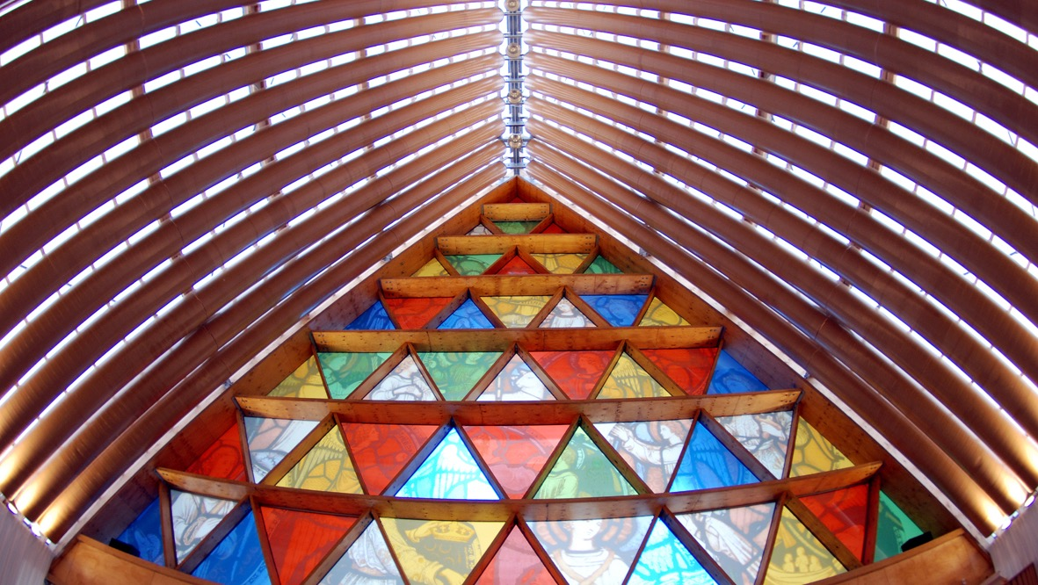
First Sunday of Advent
Year A
Isaiah 2:1-5 • Psalm 122 • Romans 13:11-14 • Matthew 24:36-44

Slide 2
...they shall beat their swords into plowshares and their spears into
pruning hooks...
Isaiah 2:4b

Slide 3
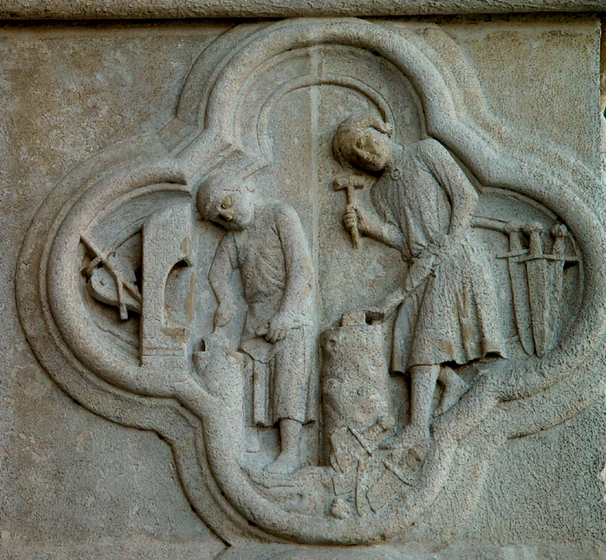
Beating Swords into Plowshares
Amiens Cathedral

Slide 4
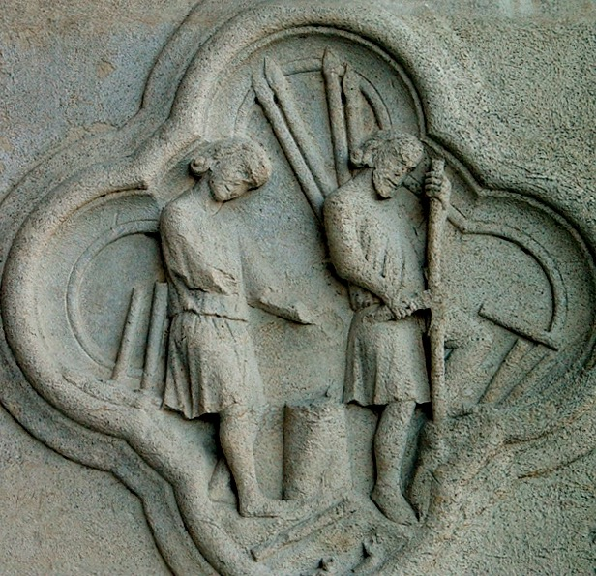
…and Spears Into Pruning Hooks
Amiens Cathedral

Slide 5
…nation shall not lift up sword against nation...
Isaiah 2:4c

Slide 6
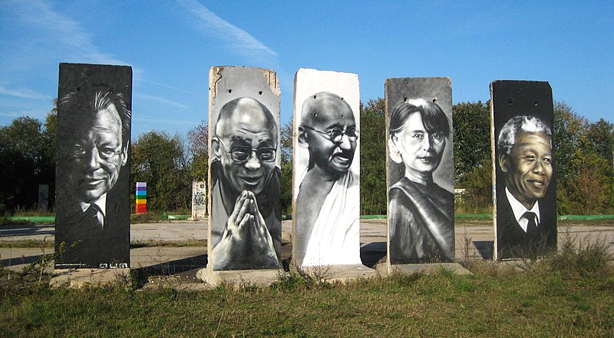
Nobel Peace Prize recipients on sections of former Berlin Wall -- Victor Landeta aka Aum

Slide 7
"Peace be within your walls,
and security within your towers." … "Peace be within you."
Psalm 122:7, 8b

Slide 8
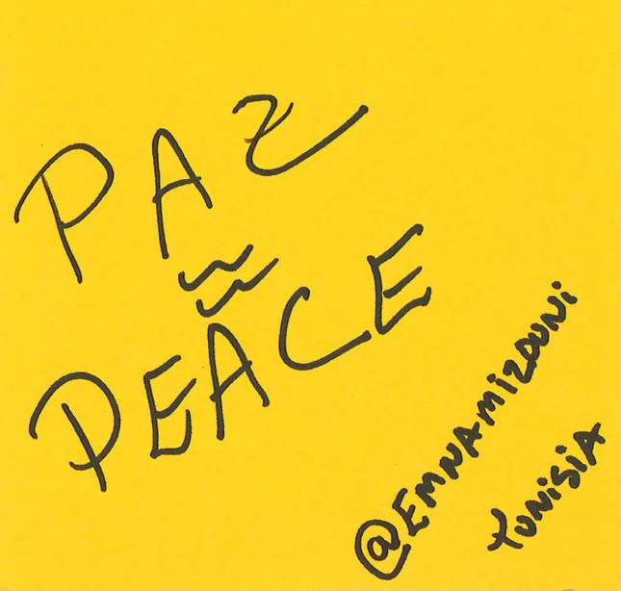
Paz = Peace
online image posted to Wikimedia
Tunisia

Slide 9
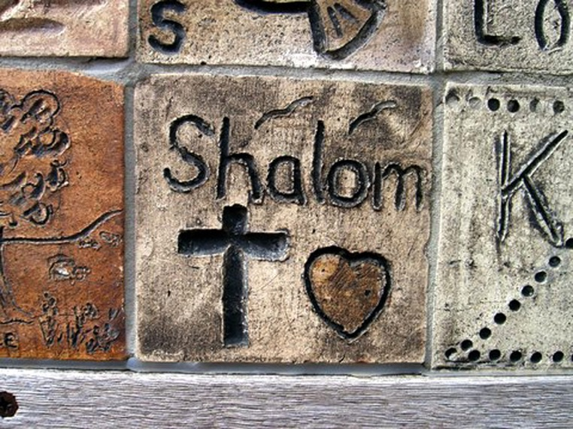
Shalom – Peace Wall -- Hamilton, New Zealand

Slide 10
"For as the days of Noah were, so will be the coming of the Son of Man. …they knew nothing until the flood came and swept them all away..."
Matthew 24:37, 39a

Slide 11
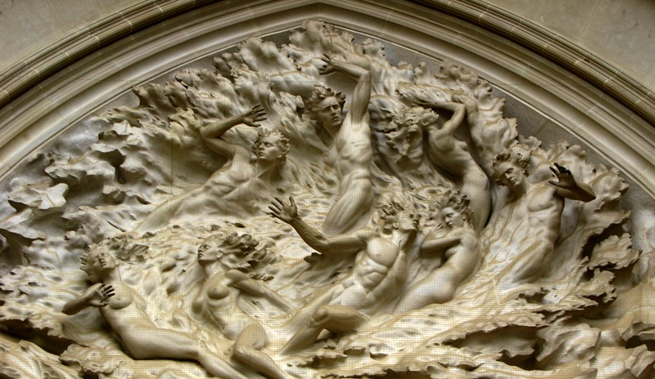
The Deluge -- Frederick Hart, Washington National Cathedral

Slide 12
"But about that day and hour no one knows…."
Matthew 24: 36a

Slide 13
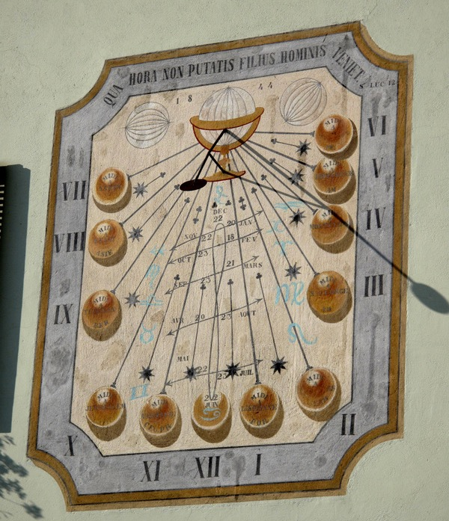
“It will be at the hour you don't think…” translation of sundial text, Rectory
Samoens, France

Slide 14
"Two women will be grinding meal together; one will be taken, and one will be left."
Matthew 24:41

Slide 15
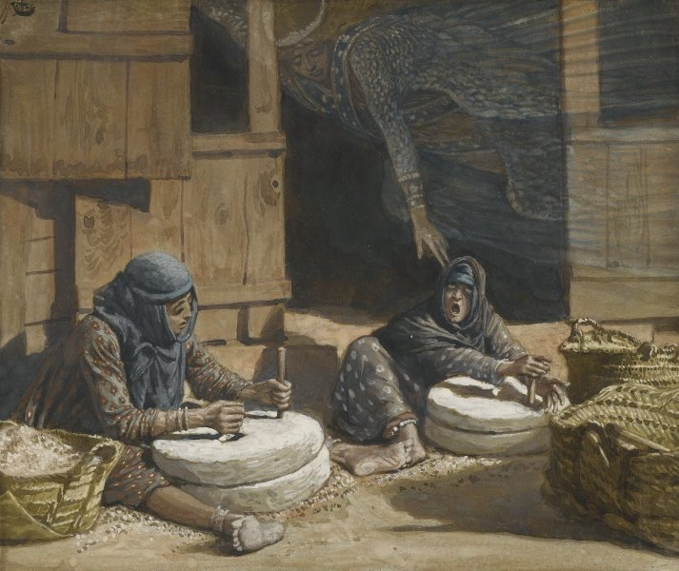
Two Women at the Mill -- James Tissot, Brooklyn Museum

Slide 16
"Therefore you also must be ready, for the Son of Man is coming at an hour you do not expect."
Matthew 24:44

Slide 17
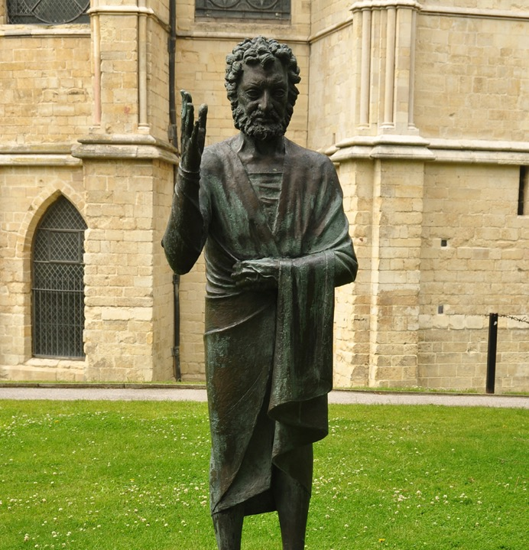
Son of Man
David McFall Canterbury Cathedral

Slide 18
…throw off the works of darkness and put on the armor of light...
Romans 13:12b

Slide 19
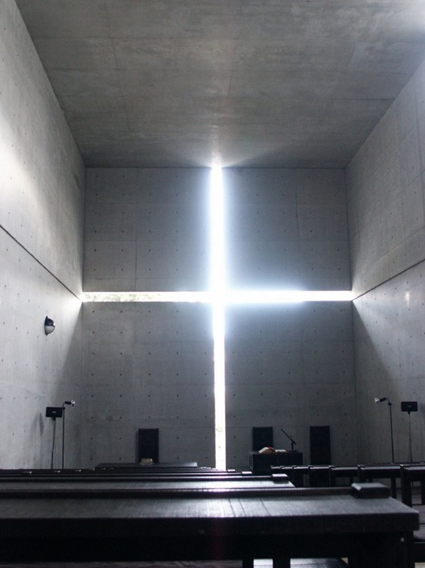
Church of the Light
Tadao Ando
Ibaraki, Japan

Slide 20
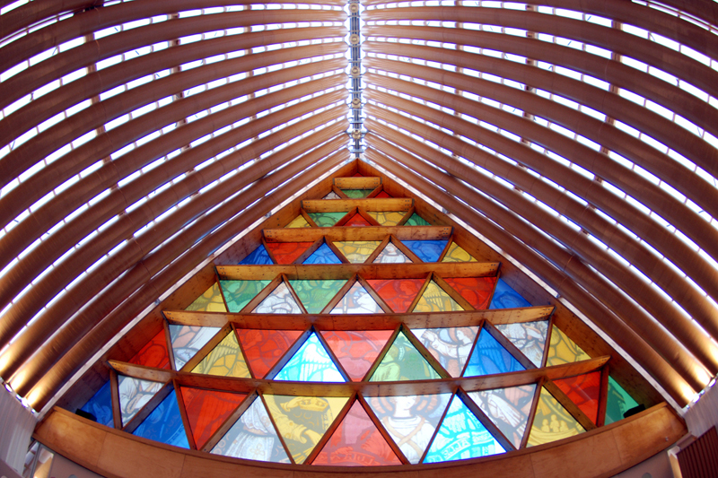
Cardboard Cathedral – Shigeru Ban, Christchurch, New Zealand

Slide 21
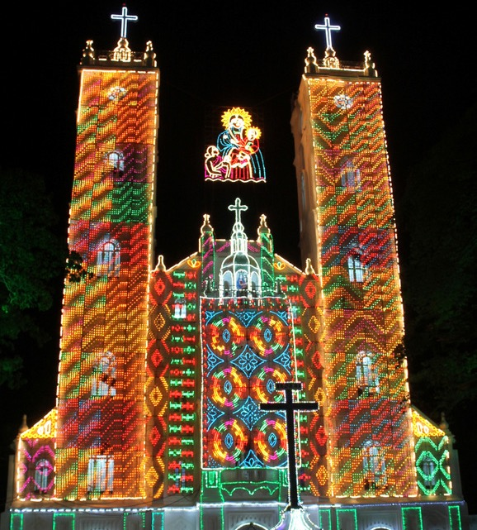
Vallarpadam Basilica
Vallarpadam, India

Slide 22
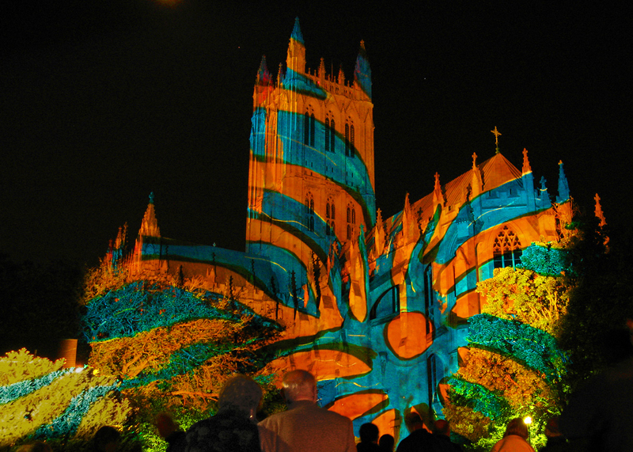
Light Upon the Cathedral – Gerry Hofstetter, National Cathedral, Washington, DC

Slide 23
…let us walk in the light of the LORD!
Isaiah 2:5b

Slide 24
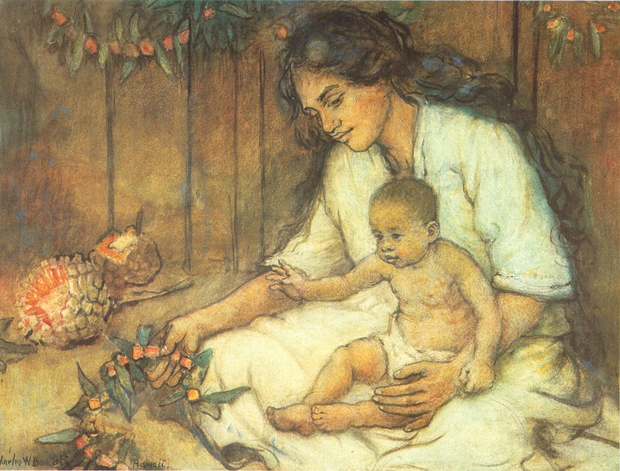
Mother and Child, Hawaii -- Charles W. Bartlett

Slide 25
Credits
New Revised Standard Version Updated Edition Bible, copyright 2022, Division of Christian Education of the National Council of the Churches of Christ in the United States of America. Used by permission. All rights reserved.
http://diglib.library.vanderbilt.edu/act-imagelink.pl?RC=29252
http://diglib.library.vanderbilt.edu/act-imagelink.pl?RC=29241
https://commons.m.wikimedia.org/wiki/File:Peace_Nobel_Price_serial_on_Berlin_Wall_segments.jpg
https://commons.m.wikimedia.org/wiki/File:Paz_peace.png
http://www.flickr.com/photos/taniwha/7186824/
http://www.flickr.com/photos/oakleyoriginals/3370999066/
http://commons.wikimedia.org/wiki/File:Eglise_de_Samoens_(Sundial).jpg
https://commons.wikimedia.org/wiki/File:Brooklyn_Museum_-_The_Two_Women_at_the_Mill_(Les_deux_femmes_au_moulin)_-_James_Tissot_-_overall.jpg
https://commons.wikimedia.org/wiki/File:Canterbury_Cathedral_34.jpg
http://commons.wikimedia.org/wiki/File:Church_of_Light.JPG
http://www.flickr.com/photos/geoftheref/9477818560
http://commons.wikimedia.org/wiki/File:Vallarpadam_Bascilica_lighted_up.jpg
http://diglib.library.vanderbilt.edu/act-imagelink.pl?RC=54875
https://commons.wikimedia.org/wiki/File:Charles_W._Bartlett_-_%27Hawaiian_Mother_and_Child%27,_watercolor_and_pastel_on_art_board,_c._1920.jpg
Additional descriptions can be found at the Art in the Christian Tradition image library, a service of the Vanderbilt Divinity Library, http://diglib.library.vanderbilt.edu/.

